Slide 1
HR ANALYSIS PROJECT
DEPI
GRADUATION PROJECT

Slide 2
Contents
TEAM INTRODUCTION | TEAM MEMBERS
PROJECT INTRODUCTION | ANALYZING EMPLOYEE BEHAVIOR, ATTRITION, SALARIES, AND SATISFACTION LEVELS
PROJECT PROCESS | DETAILED STEPS OF THE WHOLE PROCESS
PROJECT LINKS | GITHUB LINK, SERVICE LINK, POWERBI FILE LINK.

Slide 3
TEAM MEMBERS
04
02
05
01
Mostafa Mahmoud
Tasnim Emad
Mohamed Gomaa
Mislyar Hamdy
03
Sandy Safwat
06
Wedad Sayed

Slide 4
PROJECT INTRODUCTION
This HR Analysis project analyzes employee behavior, attrition trends, salaries, and satisfaction levels to help HR and management make data-driven decisions.
Through exploring key patterns in employee performance, job satisfaction, and compensation, the dashboard aims to identify the factors that influence employee turnover and engagement.

Slide 5
PROJECT PROCESS
1
DATA SOURCE
4
DAX
2
DATA CLEANING
5
VISUALS
3
MODELING
6
DASHBOARD

Slide 6
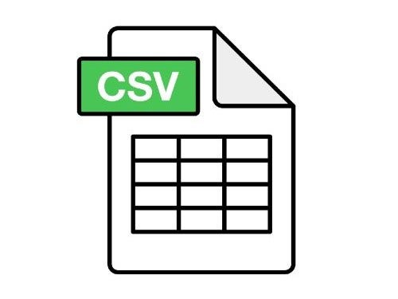
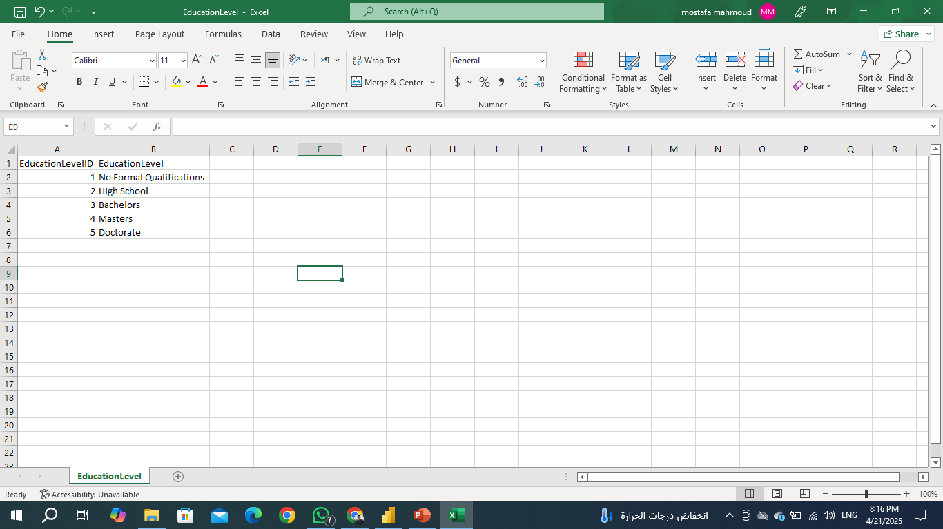
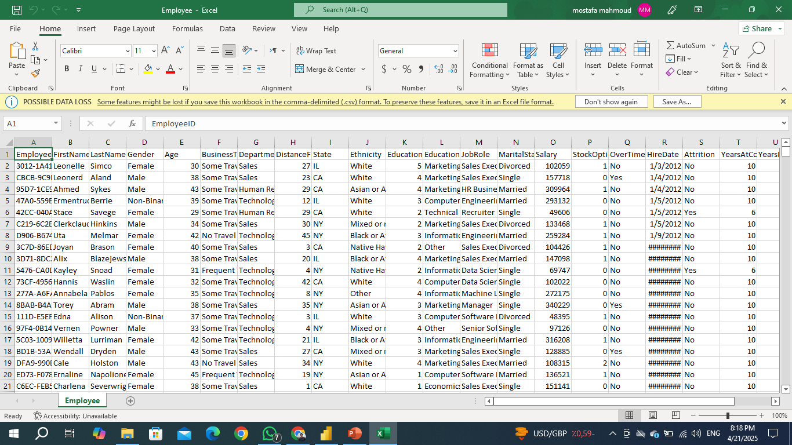
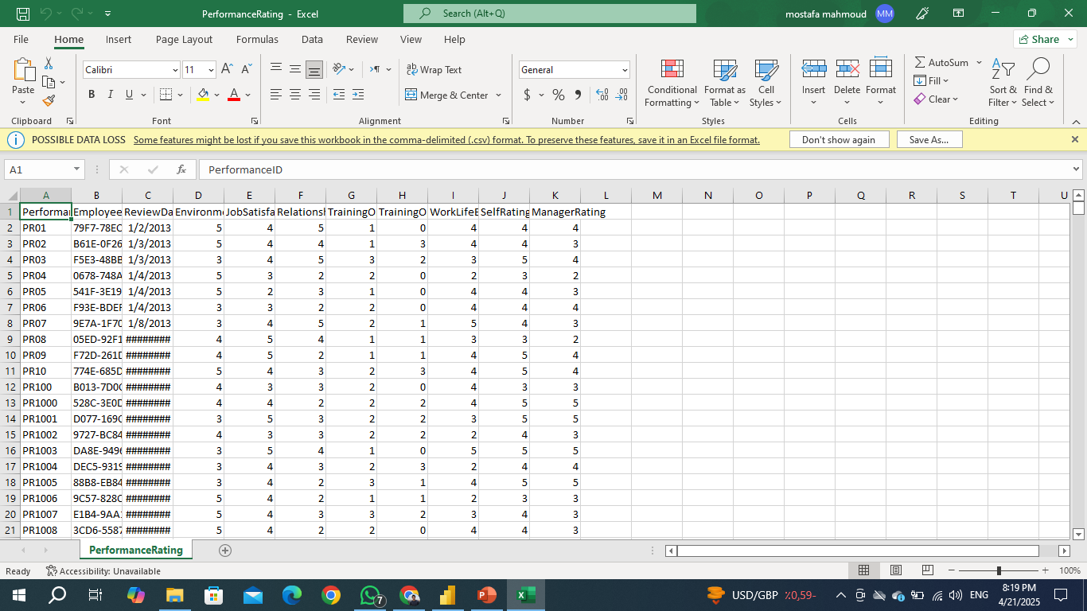
1
DATA SOURCE
ALL FILES ARE CSV
Education Level
Employee
Performance Rating

Slide 7
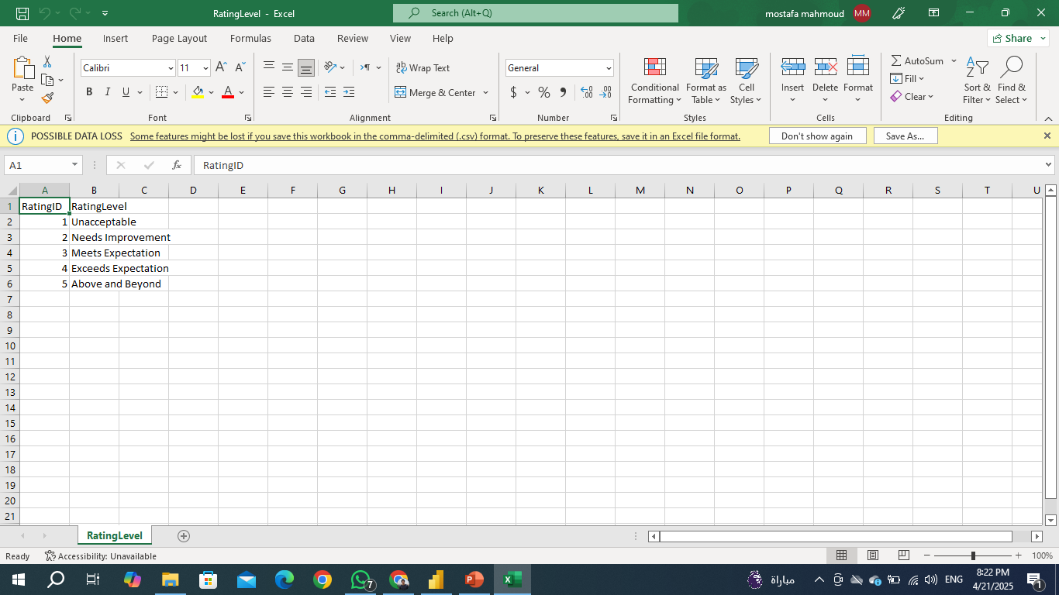
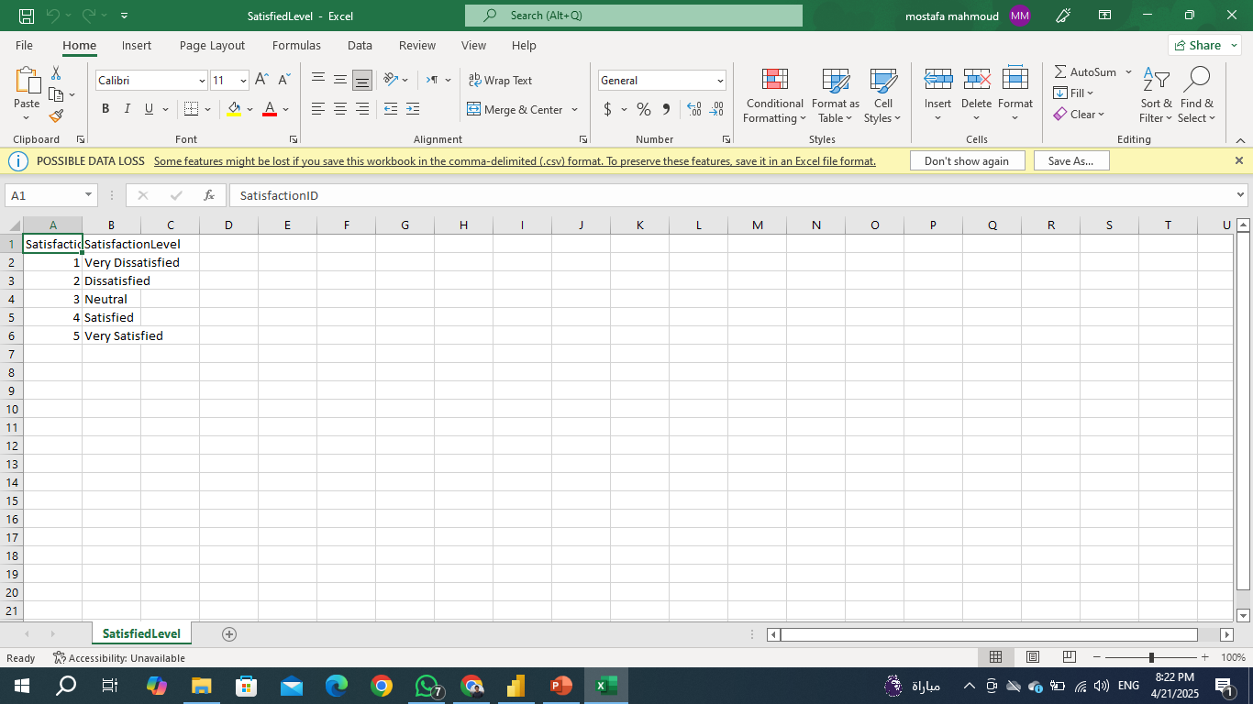
1
DATA SOURCE
Rating Level
Satisfied Level

Slide 8
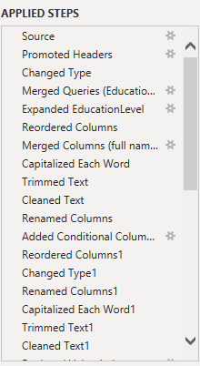
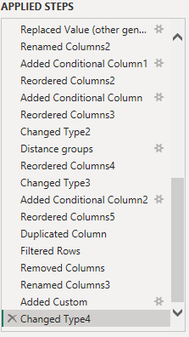
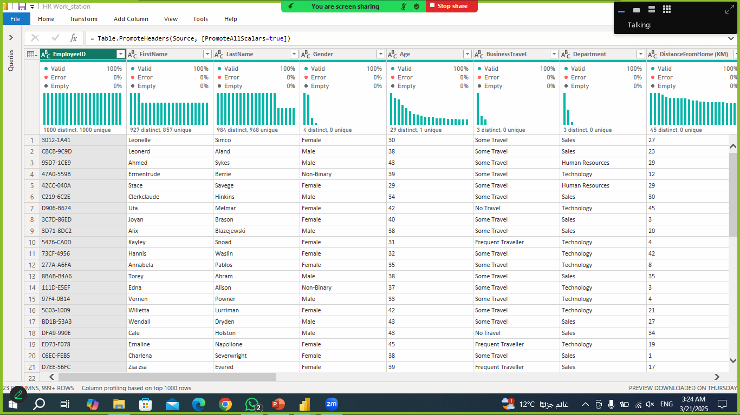
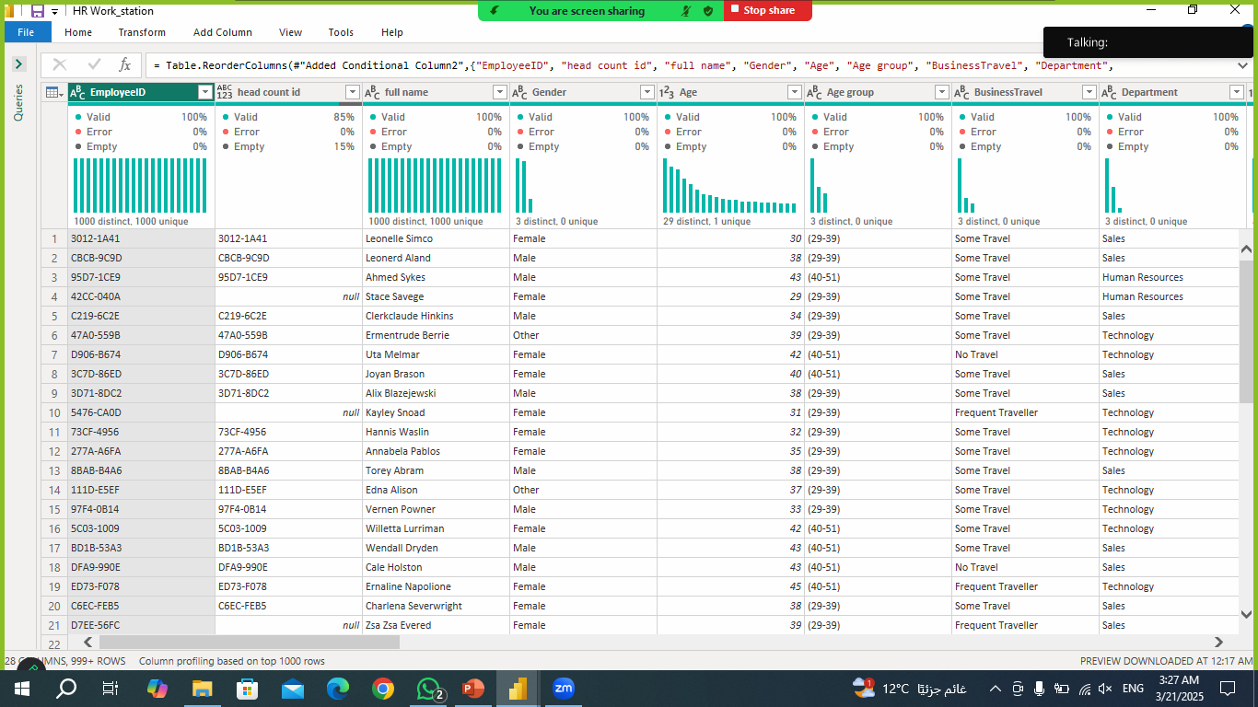
Before
2
DATA CLEANING
Employee sheet
After

Slide 9
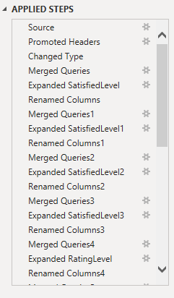
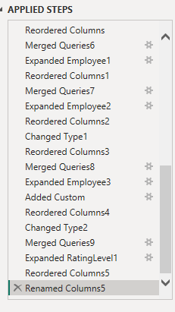
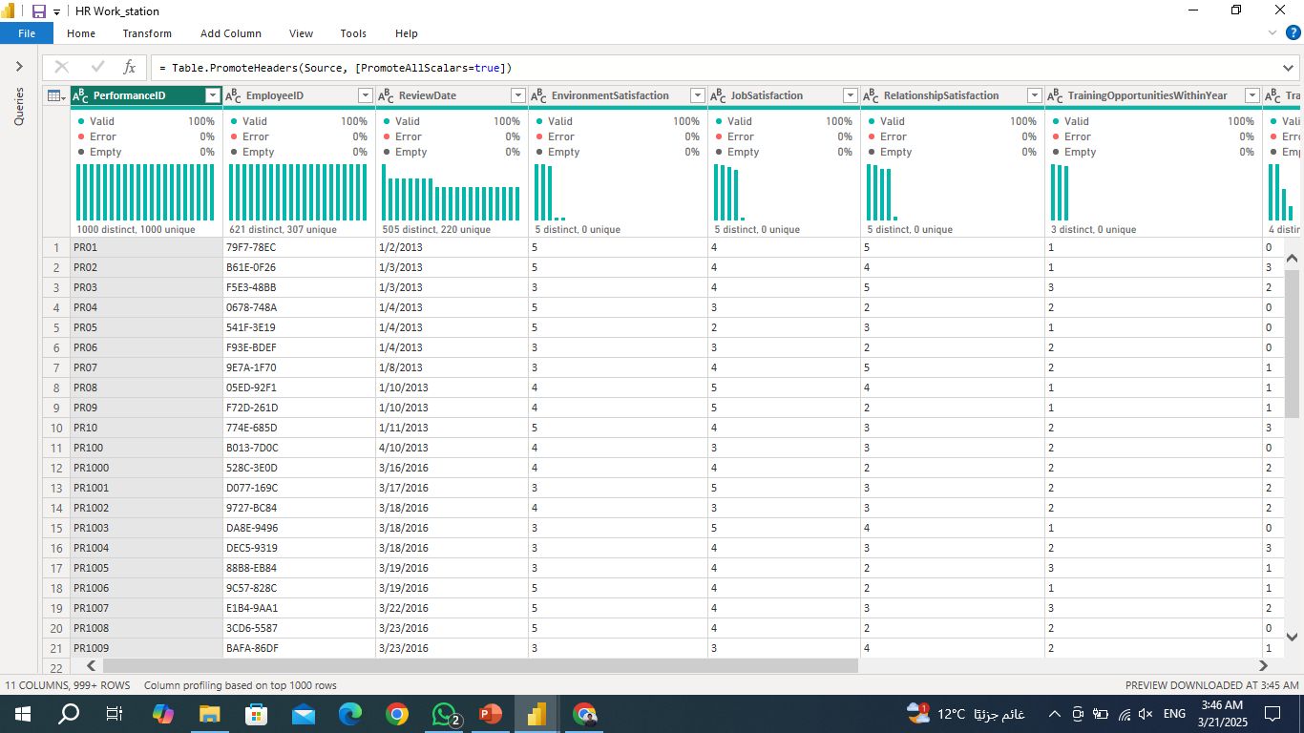
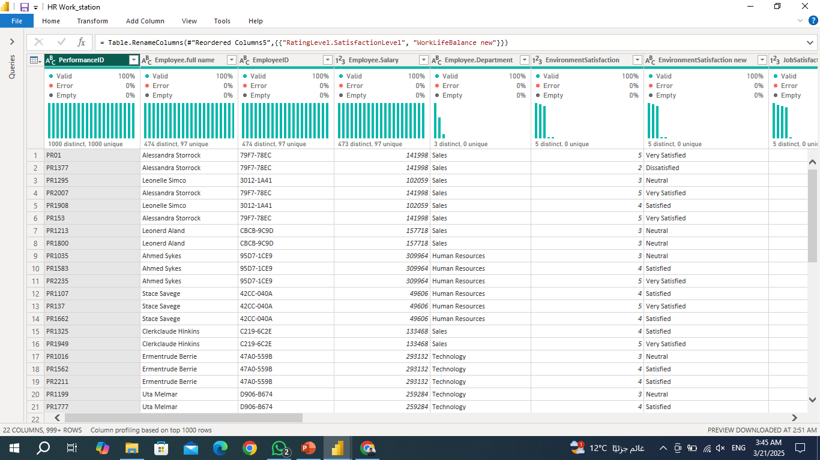
Before
2
DATA CLEANING
Performance Rating Sheet
After

Slide 10
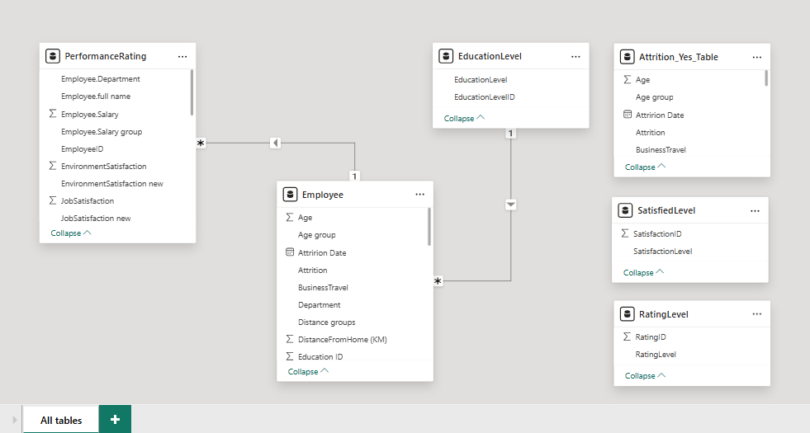
3
MODELING

Slide 11
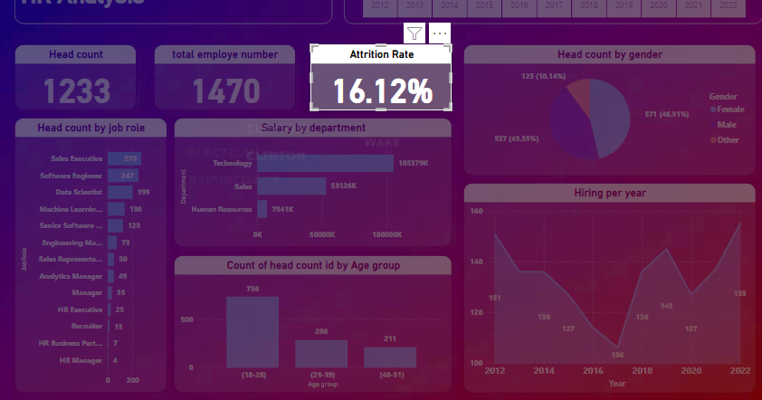
4
DAX FUNCTIONS
Total Employees = COUNTROWS(Employee)
Attrition Rate = DIVIDE(COUNTROWS(FILTER('Employee', 'Employee'[Attrition] = "Yes")), [Total Employees], 0)
Attrition Date
if [Attrition] = "Yes" then Date.AddYears([HireDate], [YearsAtCompany]) else null

Slide 12
4
DAX FUNCTIONS
Average Salary = AVERAGE(Employee[Salary])
Average Satisfaction =
AVERAGE('PerformanceRating'[JobSatisfaction new])

Slide 13
4
DAX FUNCTIONS
Employee Count by Performance =
CALCULATE(COUNTROWS('PerformanceRating'), 'PerformanceRating'[ManagerRating new] = "Exceeds Expectation")
Percentage of Training Opportunities Taken =
DIVIDE(SUM('PerformanceRating'[TrainingOpportunitiesTaken]), SUM('PerformanceRating'[TrainingOpportunitiesWithinYear]), 0)

Slide 14
4
DAX FUNCTIONS
Employee Satisfaction Score =
AVERAGEX(
'PerformanceRating',
SWITCH(TRUE(),
'PerformanceRating'[JobSatisfaction new] = "Satisfied", 3,
'PerformanceRating'[JobSatisfaction new] = "Neutral", 2,
'PerformanceRating'[JobSatisfaction new] = "Dissatisfied", 1,
'PerformanceRating'[JobSatisfaction new] = "Very Satisfied", 4,
'PerformanceRating'[JobSatisfaction new] = "Very Dissatisfied", 5,
0
)
)

Slide 15
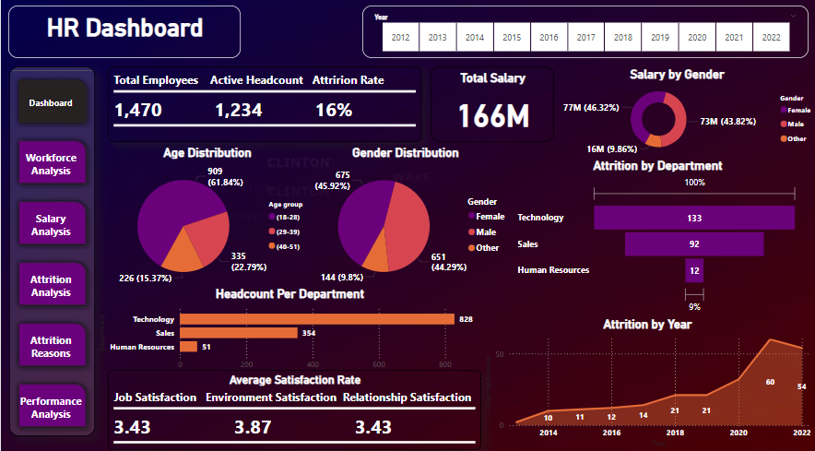
5
VISUALIZATION CHARTS

Slide 16
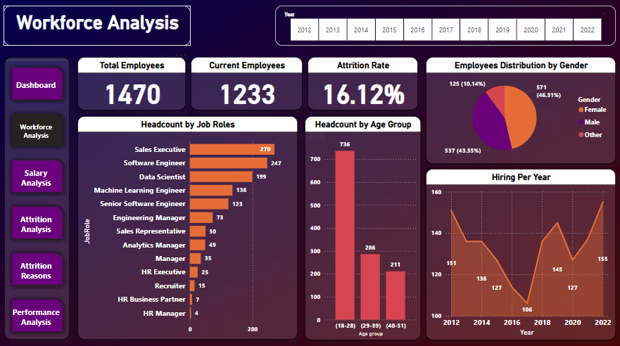
5
VISUALIZATION CHARTS

Slide 17
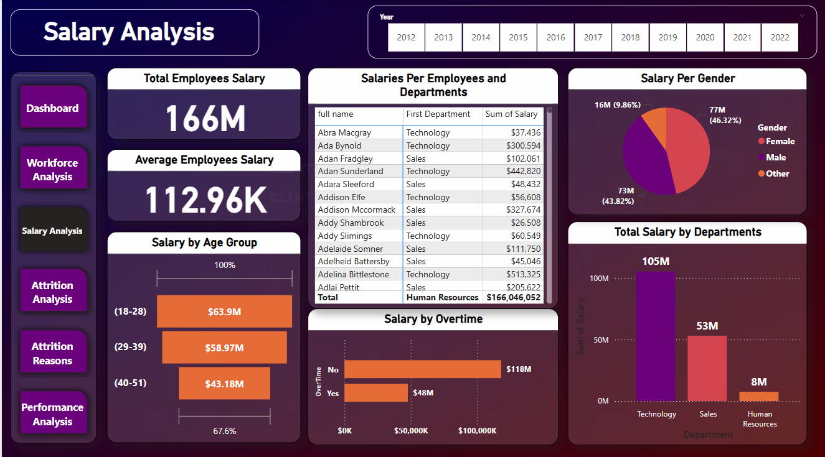
5
VISUALIZATION CHARTS

Slide 18
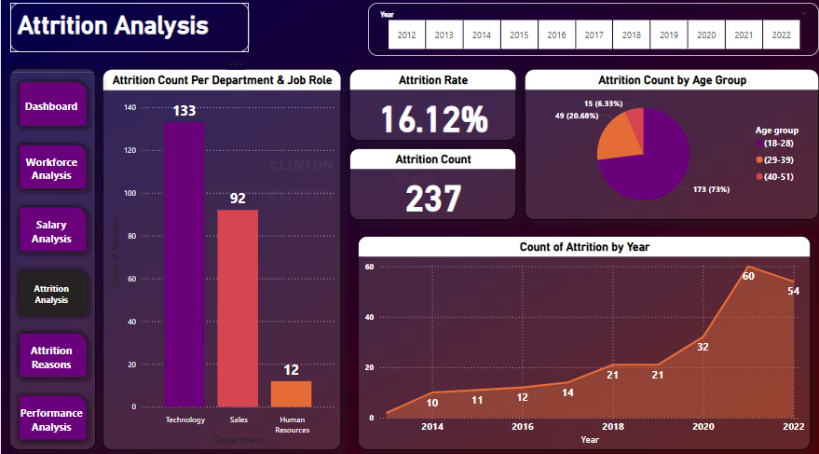
5
VISUALIZATION CHARTS

Slide 19
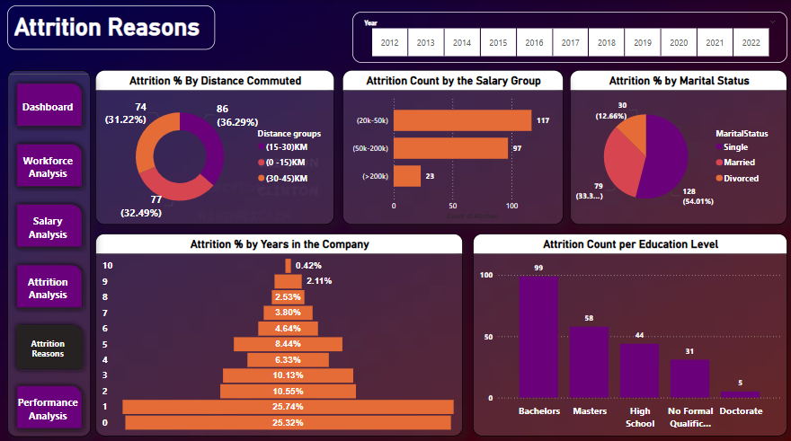
5
VISUALIZATION CHARTS

Slide 20
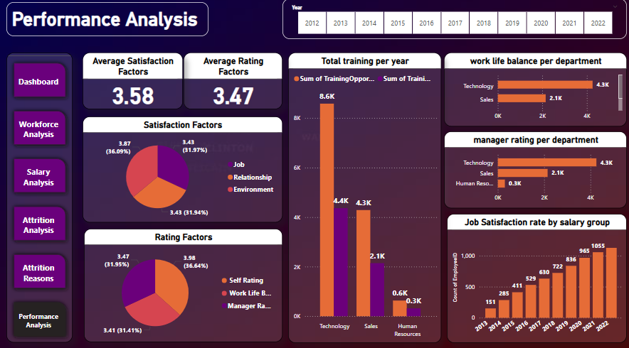
5
VISUALIZATION CHARTS

Slide 21

6
DASHBOARD

Slide 22
Project Links
GitHub link
Service
Drive Link

Slide 23
Thanks!
https://depi.gov.eg/content/home

